Slide 1
Cross Validation and Performance metric
Cross Validation and Performance metric

Slide 2
Classification vs Regression
Features | Regression | Classification
Main goal | Predicts continuous values like salary and age. | Predicts discrete values like stock and forecasts.
Input and output variables | Input: Either categorical or continuous Output: Only continuous | Input: Either categorical or continuous Output: Only categorial
Types of algorithm | Linear regression, Polynomial regression, Lasso regression, Ridge regression | Decision trees, Random forests, Logistic regression, Neural networks, Support vector machines
Evaluation metric | R2 score, Mean squared error, Mean absolute error, Absolute percentage error (MAPE) | Receiver operating characteristic curve, Auc score, Recall, Accuracy, Precision, F1 score

Slide 3
Training and Validation Data
What is the goal of machine learning?
To predict future values of unknown data.
If you are doing statistics, then you could start making assumptions about your data and start proving theorems.
Machine learning is a often a bit different, you cannot always make sensible assumptions about the distribution of your data.

Slide 4
Training and Validation Data
There are lots of reasons to split, but it avoids over-fitting. It avoids learning how to exactly predict how well you learned your training set.
When you report how well your learning algorithm does, you should report the score on validation set and not the training set.
You can compare several learning algorithms and compare their validation errors.
Statistically it is all about reducing variance.

Slide 5
Hyper-parameters - Train — Validation — Test
If we have enough data then we can split out data into three parts:
Training This is what we use to train our different algorithms. Typical split 50%.
Validation This is what we use to choose our model and
hyper-parameters. We pick the model with the best validation score. Typical split 25%.
Test This is the data that you keep back until you have picked a model. You use this to predict how well you model will do on real data. Typical split 25%.
This avoids overfitting in the model selection. If you are comparing models then you use the validation set to pick the best model, but report the error score on the test set to give an indication on how well the model will generalise.

Slide 6
k-fold cross validation
What if we don’t have enough data to split into three parts. Then we can use k-fold validation.
Split your data randomly into k equal size parts.
For each part, hold one back as a test set and train on the k − 1 remaining parts, evaluate on the part you held back.
Report the average evaluation and use this to set your hyper-parameters or to select the best model.
This effectively generates more training test splits out of your data. The random selection gives you statistically similar splits.

Slide 7
k-fold cross validation
If k = 5, then you have 5 parts T₁, . . . , T₅ you would run 5 training runs Train on T₁, T₂, T₃, T₄ evaluate on T₅.
Train on T₁, T₂, T₃, T₅ evaluate on T₄. Train on T₁, T₂, T₄, T₅ evaluate on T₃. Train on T₁, T₃, T₄, T₅ evaluate on T₂. Train on T₂, T₃, T₄, T₅ evaluate on T₁.
Good values of k are 5 or 10. Obviously the larger k is the more time it takes to run the experiments.

Slide 8
k-fold cross validation
What do you do after k-fold cross validation.
Cross validation only returns a value that is a prediction of how well the model will do on more data.
Assuming that you sample of the data is randomly drawn (not biased) then there are good statistical reasons why the k-fold valuation is a good idea.

Slide 9
k-fold cross validation
Once you have decided which model or set of parameters to use, you then train a new model over the whole data set and use that for prediction.
For example you could test if SVMs and Logistic regression on the same data-set and use k-fold cross validation to decide which model would perform best. Once you know this, you can then retrain on the whole data-set and use this model in production.

Slide 10
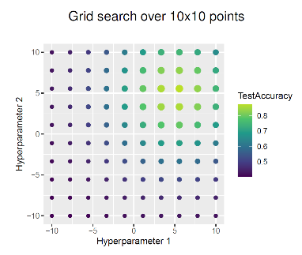
Estimating Hyper parameters — Grid Search
Simple technique which is still quite popular, tries all HP combinations on a multi-dimensional discretized grid.
A finite set of candidates is predefined for each hyperparameter.
Then, we simply search all possible combinations in arbitrary order.

Slide 11
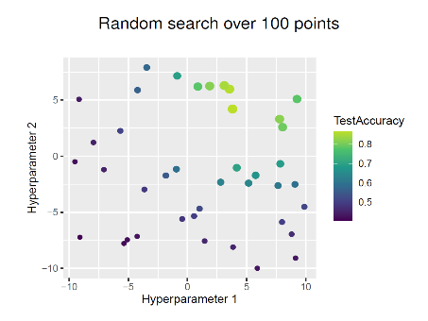
Estimating Hyper parameters — Random Search
Like grid search very easy to implement, all parameter types possible, trivial parallelization.
Anytime algorithm can stop the search whenever our budget for computation is exhausted, or continue until we reach our performance goal.
No discretization: each parameter can be tried with a different value over the entire domain in each step.

